Slide 1


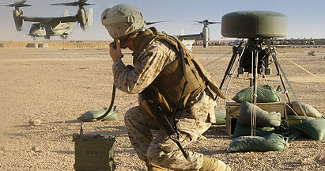
Defensive Programming, Assertions and Exceptions
Learn to Design Error Steady Code
Svetlin Nakov
Technical Trainer
www.nakov.com
Telerik Software Academy
academy.telerik.com

Slide 2


Table of Contents
What is Defensive Programming?
Assertions and Debug.Assert(…)
Exceptions Handling Principles
Error Handling Strategies

Slide 3
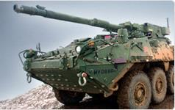
Defensive Programming
Using Assertions and Exceptions Correctly

Slide 4
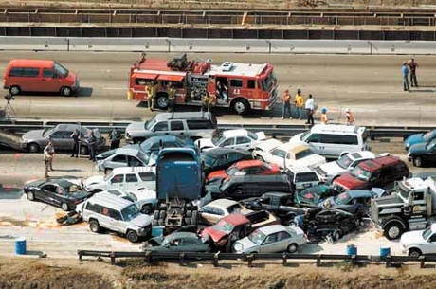
What is Defensive Programming?
Similar to defensive driving – you are never sure what other drivers will do
Expect incorrect input and handle it correctly
Think not only about the usual execution flow, but consider also unusual situations

Slide 5
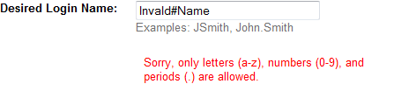
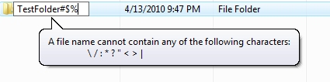
Protecting from Invalid Input
“Garbage in → garbage out” – Wrong!
Garbage in → nothing out / exception out / error message out / no garbage allowed in
Check the values of all data from external sources (from user, file, internet, DB, etc.)

Slide 6
Protecting from Invalid Input (2)
Check method preconditions
Parameters, object internal state, etc.
Check method postconditions
Method output, expected internal state, etc.
string Substring(string str, int startIndex, int length)
{
REQUIRE(str != NULL);
REQUIRE(startIndex < str.Length);
REQUIRE(startIndex + count < str.Lenght);
string result = …
ENSURE(result.Length == length);
}
Check preconditions
Main method logic
Check postconditions

Slide 7


Assertions
Checking Preconditions and Postconditions

Slide 8
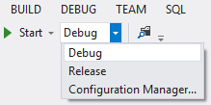
Assertions
Assertion – a statement placed in the code that must always be true at that moment
Assertions are used during development
Removed in release builds
Assertions check for bugs in code
public double GetAverageStudentGrade()
{
Debug.Assert(studentGrades.Count > 0,
"Student grades are not initialized!");
return studentGrades.Average();
}

Slide 9
Assertions (2)
Use assertions for conditions that should never occur in practice
Failed assertion indicates a fatal error in the program (usually unrecoverable)
Use assertions to document assumptions made in code (preconditions & postconditions)
private Student GetRegisteredStudent(int id)
{
Debug.Assert(id > 0);
Student student = registeredStudents[id];
Debug.Assert(student.IsRegistered);
}

Slide 10
Assertions (3)
Failed assertion indicates a fatal error in the program (usually unrecoverable)
Avoid putting executable code in assertions
Won’t be compiled in production. Better use:
Assertions should fail loud
It is fatal error → total crash
Debug.Assert(PerformAction(), "Could not perform action");
bool actionedPerformed = PerformAction();
Debug.Assert(actionedPerformed, "Could not perform action");

Slide 11
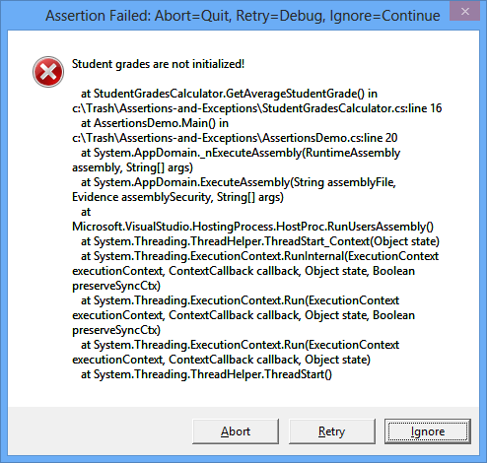
Assertions
Live Demo

Slide 12

Exceptions
Best Practices for Exception Handling

Slide 13
Exceptions
Exceptions provide a way to inform the caller about an error or exceptional events
Can be caught and processed by the callers
Methods can throw exceptions:
public void ReadInput(string input)
{
if (input == null)
{
throw new ArgumentNullException("input"); }
…
}

Slide 14
Exceptions (2)
Use try-catch statement to handle exceptions:
You can use multiple catch blocks to specify handlers for different exceptions
Not handled exceptions propagate to the caller
void PlayNextTurn()
{
try
{
readInput(input);
…
}
catch (ArgumentException e)
{
Console.WriteLine("Invalid argument!");
}
}
Exception thrown here
The code here will not be executed

Slide 15
Exceptions (3)
Use finally block to execute code even if exception occurs (not supported in C++):
Perfect place to perform cleanup for any resources allocated in the try block
void PlayNextTurn()
{
try
{
… }
finally
{
Console.WriteLine("Hello from finally!");
}
}
Exceptions can be eventually thrown here
The code here is always executed

Slide 16
Exceptions (4)
Use exceptions to notify the other parts of the program about errors
Errors that should not be ignored
Throw an exception only for conditions that are truly exceptional
Should I throw an exception when I check for user name and password? → better return false
Don’t use exceptions as control flow mechanisms

Slide 17
Exceptions (5)
Throw exceptions at the right level of abstraction
class Employee
{
…
public TaxId
{ get { throw new NullReferenceException(…); }
}
class Employee
{
…
public TaxId
{ get { throw new EmployeeDataNotAvailable(…); }
}

Slide 18
Exceptions (6)
Use descriptive error messages
Incorrect example:
Example:
Avoid empty catch blocks
throw new Exception("Error!");
throw new ArgumentException("The speed should be a number " +
"between " + MIN_SPEED + " and " + MAX_SPEED + ".");
try
{
…
}
catch (Exception ex)
{
}

Slide 19
Exceptions (7)
Always include the exception cause when throwing a new exception
try
{
WithdrawMoney(account, amount);
}
catch (DatabaseException dbex)
{
throw new WithdrawException(String.Format(
"Can not withdraw the amount {0} from acoount {1}",
amount, account), dbex);
}
We chain the original exception (the source of the problem)

Slide 20
Exceptions (8)
Catch only exceptions that you are capable to process correctly
Do not catch all exceptions!
Incorrect example:
What about OutOfMemoryException?
try
{
ReadSomeFile();
}
catch
{
Console.WriteLine("File not found!");
}

Slide 21
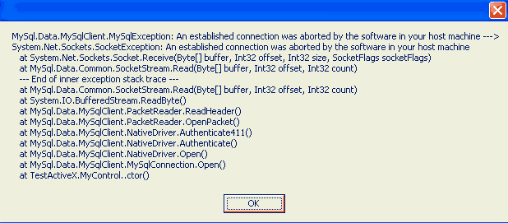
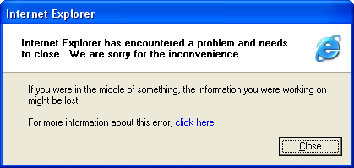
Exceptions (9)
Have an exception handling strategy for all unexpected / unhandled exceptions:
Consider logging (e.g. Log4Net)
Display to the end users only messages that they could understand
or

Slide 22

Exceptions
Live Demo
(Decompiling System.DateTime)

Slide 23



Error Handling Strategies
Assertions vs. Exceptions vs. Other Techniques

Slide 24
Error Handling Techniques
How to handle errors that you expect to occur?
Depends on the situation:
Throw an exception (in OOP)
The most typical action you can do
Return a neutral value, e.g. -1 in IndexOf(…)
Return an error code (in old languages / APIs)
Display an error message in the UI
Return the same answer as the previous time
Log a warning message to a file
Crash / shutdown / reboot

Slide 25
Assertions vs. Exceptions
Exceptions are announcements about error condition or unusual event
Inform the caller about error or exceptional event
Can be caught and application can continue working
Assertions are fatal errors
Assertions always indicate bugs in the code
Can not be caught and processed
Application can’t continue in case of failed assertion
When in doubt → throw an exception

Slide 26
Assertions in C#
Assertions in C# are rarely used
In C# prefer throwing an exception when the input data / internal object state are invalid
Exceptions are used in C# and Java instead of preconditions checking
Prefer using unit testing for testing the code instead of postconditions checking
Assertions are popular in C / C++
Where exceptions & unit testing are not popular
In JS there are no built-in assertion mechanism

Slide 27
Error Handling Strategy
Choose your error handling strategy and follow it consistently
Assertions / exceptions / error codes / other
In C#, .NET and OOP prefer using exceptions
Assertions are rarely used, only as additional checks for fatal error
Throw an exception for incorrect input / incorrect object state / invalid operation
In JavaScript use exceptions: try-catch-finally
In non-OOP languages use error codes

Slide 28
Robustness vs. Correctness
How will you handle error while calculating single pixel color in a computer game?
How will you handle error in financial software? Can you afford to lose money?
Correctness == never returning wrong result
Try to achieve correctness as a primary goal
Robustness == always trying to do something that will allow the software to keep running
Use as last resort, for non-critical errors

Slide 29
Assertions vs. Exceptions
public string Substring(string str, int startIndex, int length)
{
if (str == null)
{
throw new NullReferenceException("Str is null.");
}
if (startIndex >= str.Length)
{
throw new ArgumentException(
"Invalid startIndex:" + startIndex);
}
if (startIndex + count > str.Length)
{
throw new ArgumentException("Invalid length:" + length);
}
…
Debug.Assert(result.Length == length);
}
Check the input and preconditions
Perform the method main logic
Check the postconditions

Slide 30




Error Barricades
Barricade your program to stop the damage caused by incorrect data
Consider same approach for class design
Public methods → validate the data
Private methods → assume the data is safe
Consider using exceptions for public methods and assertions for private
public methods / functions
private methods / functions
safe data

Slide 31
Being Defensive About Defensive Programming
Too much defensive programming is not good
Strive for balance
How much defensive programming to leave in production code?
Remove the code that results in hard crashes
Leave in code that checks for important errors
Log errors for your technical support personnel
See that the error messages you show are user-friendly

Slide 32
Defensive Programming
http://academy.telerik.com

Slide 33
Homework
For the exercises use the Visual Studio solution "9. Assertions-and-Exceptions-Homework.zip".
Add assertions in the code from the project "Assertions-Homework" to ensure all possible preconditions and postconditions are checked.
Add exception handling (where missing) and refactor all incorrect error handling in the code from the "Exceptions-Homework" project to follow the best practices for using exceptions.

Slide 34




Free Trainings @ Telerik Academy
C# Programming @ Telerik Academy
csharpfundamentals.telerik.com
Telerik Software Academy
academy.telerik.com
Telerik Academy @ Facebook
facebook.com/TelerikAcademy
Telerik Software Academy Forums
forums.academy.telerik.com

